Slide 1


AstroSage Call Center Performance Analysis
Optimizing Operations with Data-Driven Insights
Detailed analysis of key call center metrics including call volume, resolution rates, and customer satisfaction for December 2023 - January 2024.
Presented by Sunny Bibyan
27-Sept-2025

Slide 2
Introduction & Objectives
Hook: “Over 57% of AstroSage’s Call consultations come from repeat callers — highlighting critical efficiency gaps.”
Objectives:
Analyze call volumes & satisfaction.
Identify efficiency gaps & workload imbalance.
Recommend strategies to improve outcomes.

Slide 3
Data Overview
Source: AstroSage Call Center system logs
Size: 28,027 consultation records
Attributes: 35 columns capturing user, guru, call/chat status, durations, ratings, financials (amount, earnings, netAmount), and operational metadata
Time Period Covered: December 2023 – January 2024
Scope of Analysis:
User behavior (repeat vs new callers)
Guru performance & workload distribution
Call outcomes (completed, failed, busy, no-answer)
Revenue generation by service type (Calls, Chats, Live Sessions)
Customer satisfaction (CSAT ratings)

Slide 4
Methodology
Analytical Approach
Data Cleaning: Standardization, missing value imputation.
Exploratory Analysis: PivotTables, trend analysis, correlations.
Visualization: Bar charts, pie charts, heatmaps, correlation plots.
KPI Identification: Call volume, cost, agent utilization, satisfaction.
Strategic Insights: Linking performance gaps to investment priorities.
Tools Used
Microsoft Excel (PivotTables, conditional formatting, charts)
Statistical functions (COUNT, AVERAGE, CORREL, STDEV)
Dashboard creation with interactive filters

Slide 5
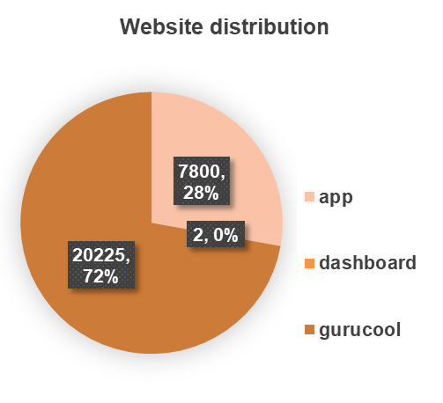
Where are our users coming from?
Majority of users come from Gurucool (72%), followed by the App (28%), while the dashboard is barely used – showing a clear preference for mobile and platform-first access.

Slide 6
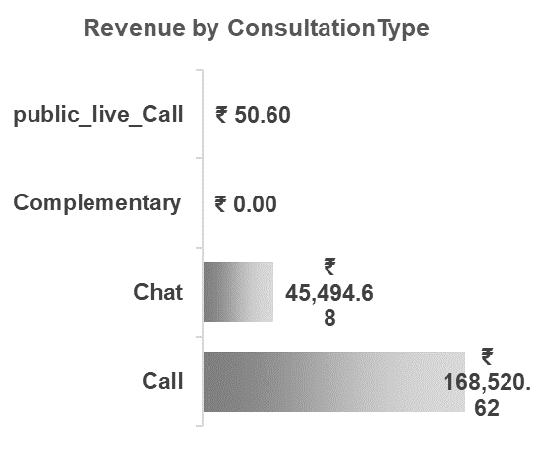
Which consultation type drives revenue?
Calls generate the highest revenue (₹1.68 lakh), followed by Chats (₹45k). Public live calls add negligible contribution. Complementary sessions bring no direct revenue.

Slide 7
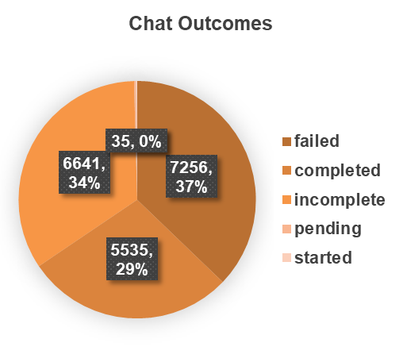
How do chats end?
37% of chats are completed, 34% failed, and 29% are incomplete. Chat efficiency still has room for improvement.

Slide 8
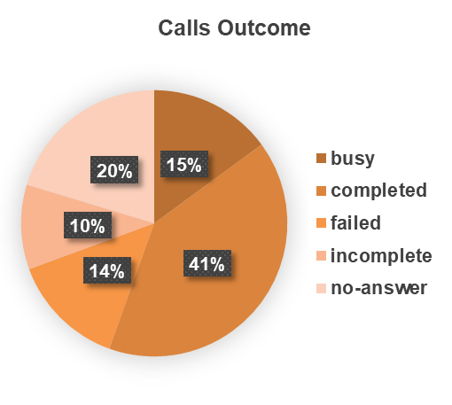
How do calls end?
41% calls are completed, but 15% failed and 20% remained unanswered. This suggests call handling efficiency can be improved.

Slide 9
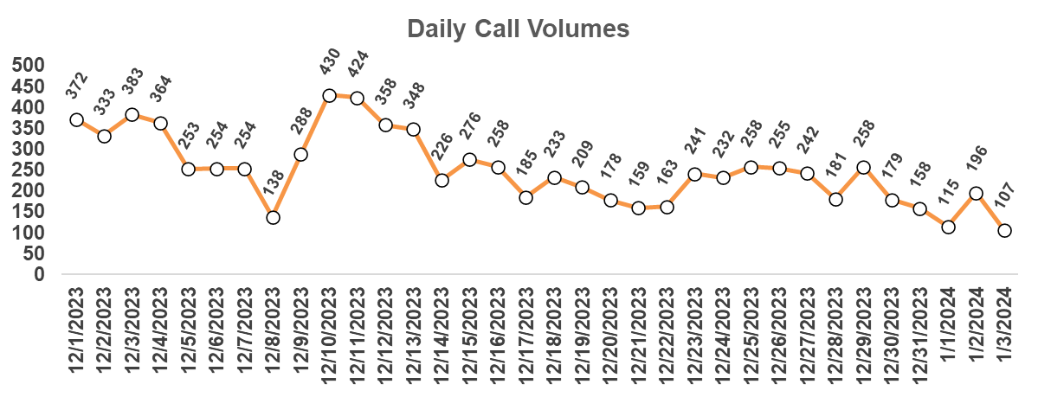
What’s the trend of daily call volumes?
Call volumes fluctuate between 150–450 daily. Noticeable dips are seen around mid-December, possibly due to seasonality.

Slide 10
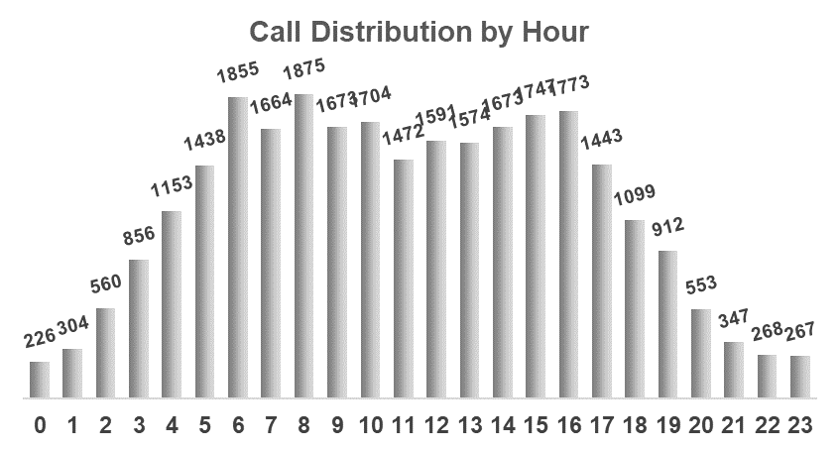
When do customers connect the most?
Peak activity is between 7 AM – 5 PM, with the highest volume around 2–4 PM. This is the critical window for resource allocation.

Slide 11
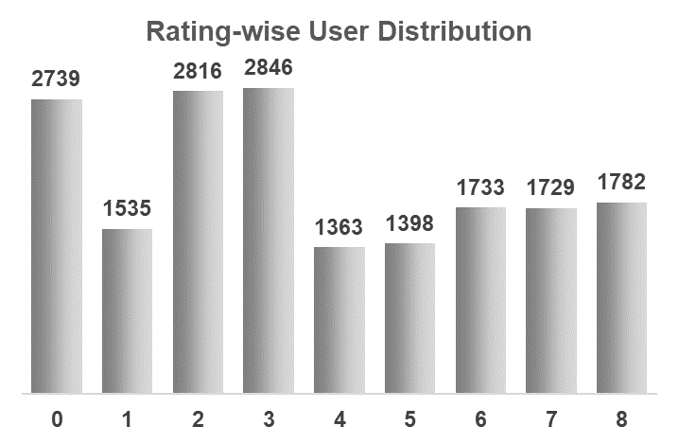
How do users rate their experience?
Most users rate between 2–4, with 2,846 users giving a rating of 3. Very few rate at extremes (0 or 8). This indicates moderate satisfaction.

Slide 12
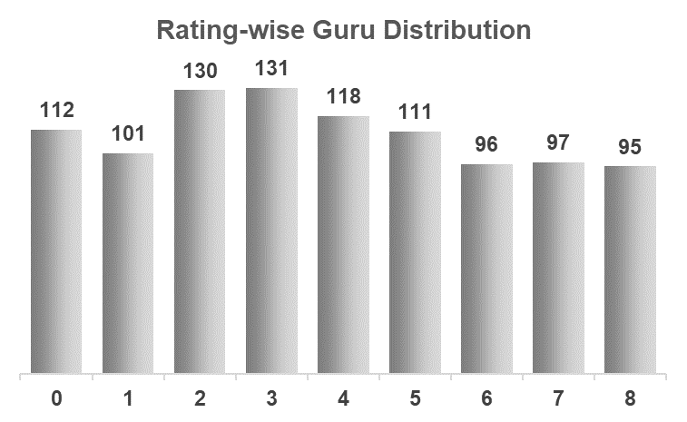
How are gurus rated?
Most gurus are rated around 2–4 as well. Very few achieve top ratings. This aligns with user distribution, showing consistency in perception.

Slide 13
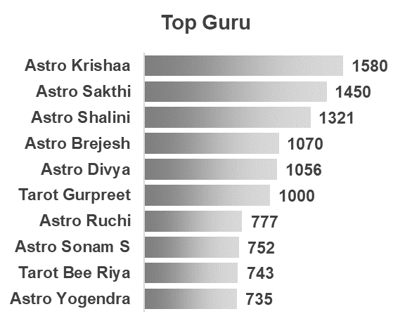
Who are the top gurus?
Astro Krishaa, Sakthi, and Shalini lead the chart with the highest user interactions. These top 3 together contribute significantly to engagement.

Slide 14
Strategic Recommendations
Tech Upgrade (Priority): CRM + AI Routing + Speech Analytics → efficiency boost.
Training Programs: Guru Excellence Program → uplift low performers using top-guru practices.
Customer Retention: Reduce 57.35% repeat calls via FCR, callbacks & chatbot support.
Performance Monitoring: Live dashboards & incentive-linked KPIs → continuous improvement.
Impact: Balanced workload, higher CSAT, reduced repeat calls, long-term profitability.

Slide 15
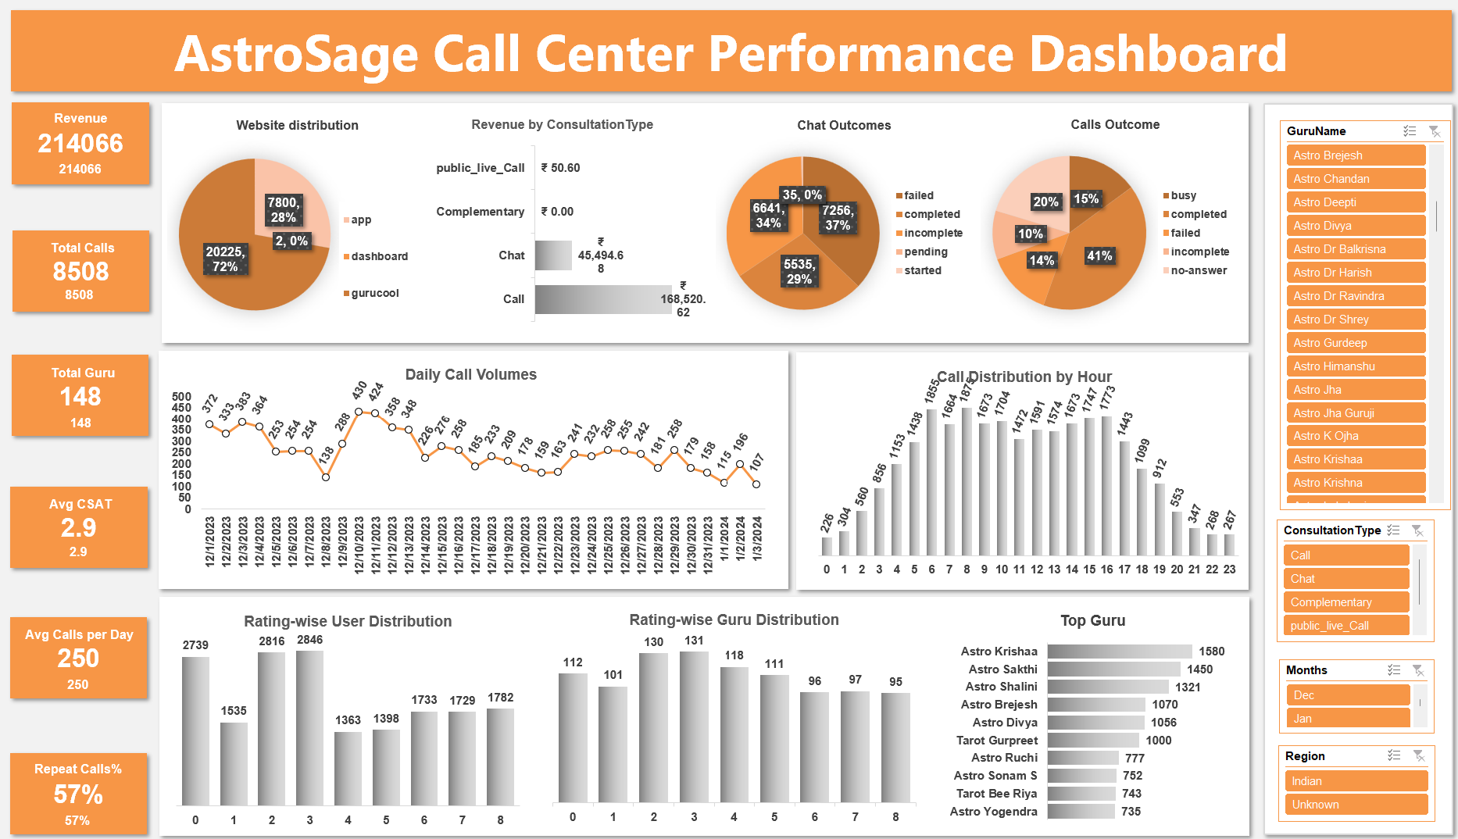
Interactive slicers for Guru, Month, Consultation Type.
Provides one-view performance monitoring for management.

Slide 16
Conclusion
The analysis of 28,027 consultations revealed critical inefficiencies: only 40% completion rate and 57% repeat calls, signaling urgent need for transformation.
Customer satisfaction is skewed towards lower ratings (0–3), proving that current processes do not consistently deliver value.
However, top-performing gurus achieving ratings of 7.5 show that quality benchmarks exist, and with structured training, these practices can be scaled across the team.
Strategic investment allocation across Technology, Training, Incentives, and Hiring ensures a balanced transformation approach — improving efficiency, enhancing customer loyalty, and securing profitability.
"By combining data-driven insights with smart investments, AstroSage has the opportunity to convert today’s inefficiencies into tomorrow’s competitive advantage — creating a call center that is not only efficient, but also customer-centric and future-ready."

Slide 17


